Slide 1
The multiplicative group modulo p: a primer for dummies

Slide 2
What is a group?
(G, ○)
G = set of elements (group members)
○ = operation (group operation)
4 properties:
Closure: for any g₁, g₂: g_{x} = g₁○g₂ must be a group member
Identity: there is a group member I such that g ○I = I ○g = g
Inverse: for any g, there is g⁻¹ such that g ○g⁻¹ = I
Associativity: for any g₁, g₂, g₃: (g₁ ○ g₂) ○ g₃ = g₁ ○ (g₂ ○ g₃)
If also commutative → Abelian Group

Slide 3
The Zp* group
multiplicative group modulo prime p
Set of p-1 elements {1,2,…, p-1} → finite group
Multiplicative = we only care about multiplications mod p!!
Forget the sum, here (otherwise you would have a field Fp)
Group properties:
Closure: obvious
Identity: obvious
Associativity: obvious
Commutativity → Abelian group → also obvious
What about inverse???
If mod N, then x has inverse if and only if gcd(x,N)=1
If N=p=prime, then all elements have inverse!
Note that 0 is not an element of the group!

Slide 4
Example: Z₁₁*
Elements: {1,2,3,4,5,6,7,8,9,10}
Inverses:
1→1
2→6 6→2
3→4 4→3
5→9 9→5
7→8 8→7
10→10 (analogous to -1)
How to compute inverses for large groups?
Extended euclidean algorithm

Slide 5
Example: find 9⁻¹ mod 11
GCD[11,9]=1 → coprime → OK
Find r,s s.t. 11 r + 9 s = 1
r
s
val
11x(-4)+9x5=1
1
0
11
0
1
9
1
1
-1
2
4
9x5 = 1 mod 11
-4
5
1
=
9⁻¹ = 5 mod 11

Slide 6
Back to multiplicative groups: exponentiation
x^{k} = x ○ x ○ x ○ … ○ x (k times)
Generator of group of order m
exists g such that {g⁰,g¹,…g^{m-1}} = all m group members
Prime-order group:
If m is prime, any member is generator
Except the identity
Is Zp* a prime order group? NO!!
|Zp*| = p-1 CANNOT be prime
p is prime → p-1 is even

Slide 7
Example: Z₁₁*
Elements: {1,2,3,4,5,6,7,8,9,10}
Generators? {g¹,g²,g³,…,g¹⁰}=?
g=2 → {2,4,8,5,10,9,7,3,6,1} OK, generator
g=3 → {3,9,5,4,1,3,9,5,4,1} NO! Subgroup order 5
g=4 → {4,5,9,3,1,4,5,9,3,1} NO! Subgroup order 5
g=5 → {5,3,4,9,1,5,3,4,9,1} NO! Subgroup order 5
g=6 → {6,3,7,9,10,5,8,4,2,1} OK, generator
g=7 → {7,5,2,3,10,4,6,9,8,1} OK, generator
g=8 → {8,9,6,4,10,3,2,5,7,1} OK, generator
g=9 → {9,4,3,5,1,9,4,3,5,1} NO! Subgroup order 5
g=10→ {10,1,10,1,10,1,10,1,10,1} NO! Subgroup order 2
Take home:
either g is a generator
Or generates a SUBGROUP → order = factor of |G|
And Zp* as well as all subgroups are cyclic!

Slide 8
Strong primes
Prime p such that p = 2q +1 being q also prime!
Order of Zp*: p-1 p-1 = 2q
Hence, any member x (except 1 and p-1) either
Generates the whole group, or
Generates subgroup of prime order q
Both large if p and q large!
Note the difference when Zp* uses «just» a large prime p: p-1 can factor down in small numbers!

Slide 9
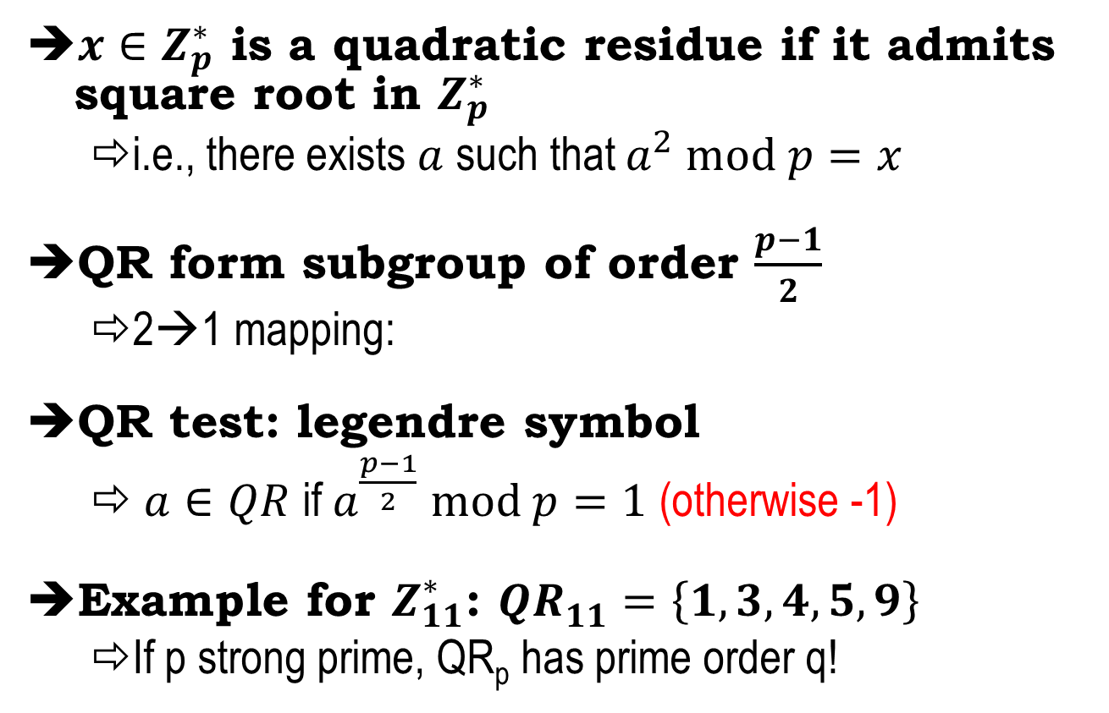
Quadratic residue subgroup
$x∈Z_{p}^{∗}$ is a quadratic residue if it admits square root in $Z_{p}^{∗}$
i.e., there exists $a$ such that $a^{2} mod p=x$
QR form subgroup of order $\frac{p−1}{2}$
2→1 mapping:
QR test: legendre symbol
$a∈QR$ if $a^{\frac{p−1}{2}} mod p=1$ (otherwise -1)
Example for $Z_{11}^{∗}$: ${QR}_{11}^{}=\left\{1,3,4,5,9\right\}$
If p strong prime, QR_{p} has prime order q!
x
p-x
x²
Indeed, (p-x)² mod p = p² – 2px + x² mod p = x²

